Slide 1
Sauce Labs
a case study in browser testing automation

Slide 2
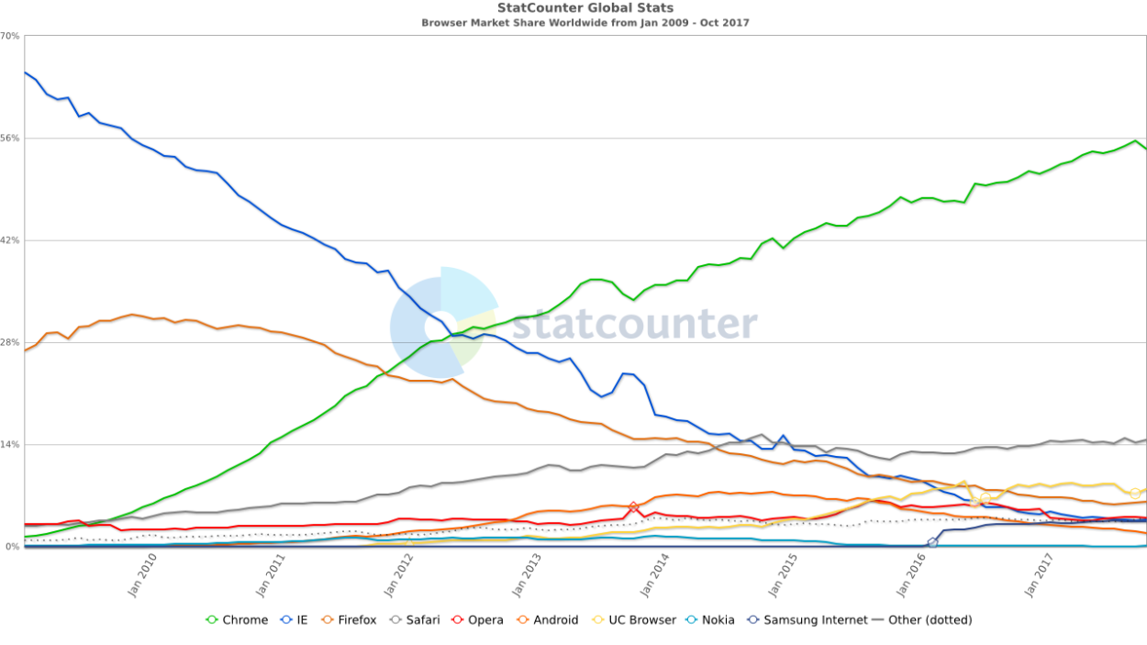

Slide 3
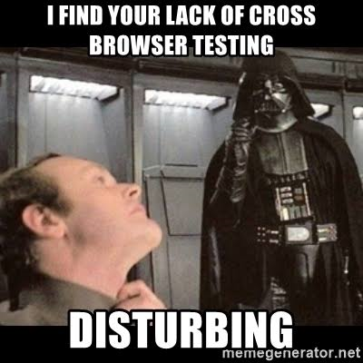
Benefits of automated browser testing
Automate all things
Safeguard critical functionality
Automation works 24/7
Avoid human errors
Parallel execution
Reusability/extendability
Reports/telemetry

Slide 4
Automated browser testing platforms
Sauce Labs
BrowserStack
Perfecto
LambdaTest
Applause
SeeTest
AWS Device Farm
Xamarin Test Cloud
Selenium Grid on any cloud

Slide 5
DEMO

Slide 6
Compare with BrowserStack
Sauce Labs PROs:
Quicker browser availability
More minor versions
Better support
Better integration
More stable (allegedly)
Sauce Labs CONs:
More expensive
Payment plans less flexible
Slower
Less documentation (becoming better)

Slide 7
QA

Slide 8
https://github.com/ebt-techtalk/sauce-labs

Slide 9
THANK YOU
Dmitriy Podrezov
Software Developer
dpodrezov@eastbanctech.com
571-598-7316
eastbanctech.com

